Slide 1
Advanced Linked Lists
Lecture # 9

Slide 2
Advanced Linked Lists
Doubly Linked List
Circular Linked List
Multi-Linked List

Slide 3
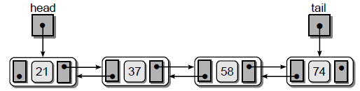
Doubly Linked List
Each node contains not only the data component and a link to the next node as in the singly linked list, but also a second link that points to the preceding node.
A head reference is again used to reference the first node in the list.
A tail reference, is commonly used with a doubly linked list to take advantage of the reverse chain, which allows for traversals from back to front.
The last node is indicated by a null reference in the next link of the last node.

Slide 4
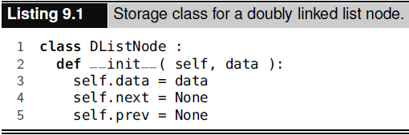
Doubly Linked List

Slide 5
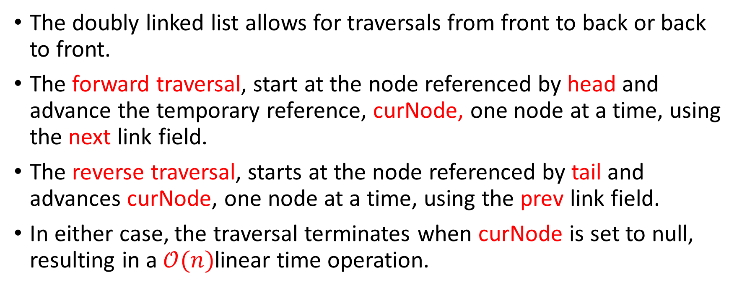
List Operations - Traversal
The doubly linked list allows for traversals from front to back or back to front.
The forward traversal, start at the node referenced by head and advance the temporary reference, curNode, one node at a time, using the next link field.
The reverse traversal, starts at the node referenced by tail and advances curNode, one node at a time, using the prev link field.
In either case, the traversal terminates when curNode is set to null, resulting in a $𝒪(n)$linear time operation.

Slide 6
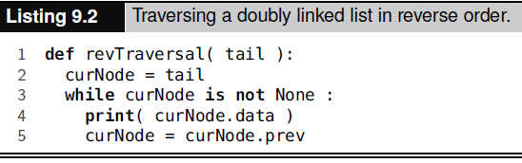
List Operations - Traversal

Slide 7
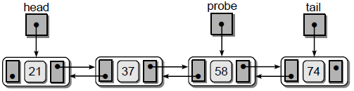
List Operations - Search
A doubly linked list, we can move forward or backward.
Search the value 58, as shown in the figure.
The external reference probe to iterate through the list, the target is found in the third node.
If we leave probe pointing to the third node, we can begin the next search operation where the previous search left off.
Suppose the next search is for value 37. We can compare this target value to the item currently referenced by probe and determine if the search should proceed forward or backward starting from the probe node.

Slide 8
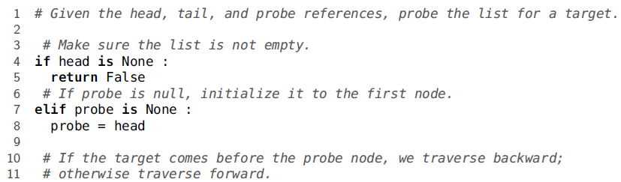
List Operations - Search

Slide 9
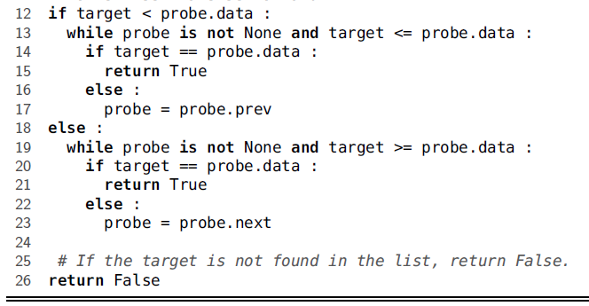
List Operations - Search

Slide 10
List Operations – Adding Node
A new node inserted into the middle of a sorted doubly linked list.
Once the position for the new node is located, we can access its predecessor using the appropriate prev field.
The location of the new node is found by positioning a single temporary external reference variable to point to the node containing the first value larger than the new value.
After this position is found, the new node can be linked into the list using the various prev and next node fields.

Slide 11
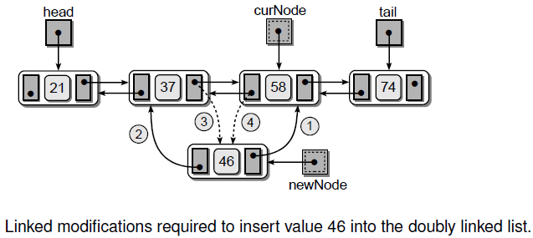
List Operations – Adding Node

Slide 12
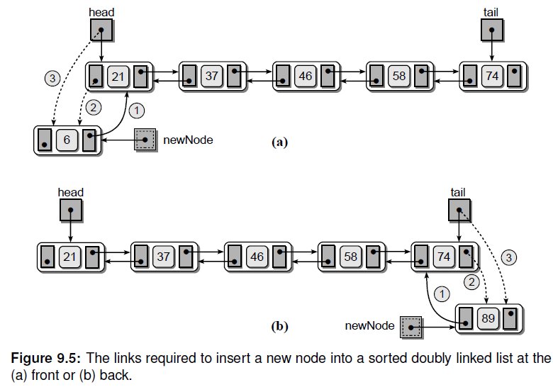
List Operations – Adding Node

Slide 13
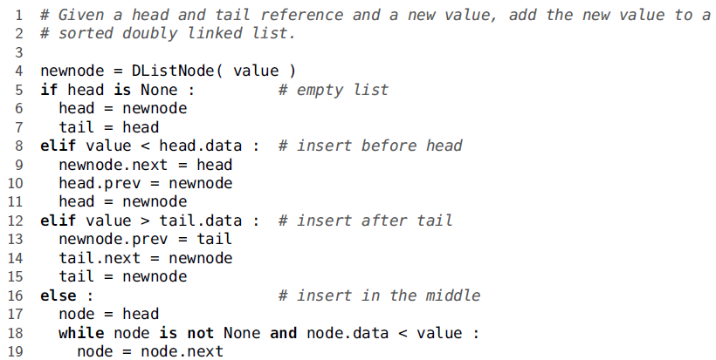
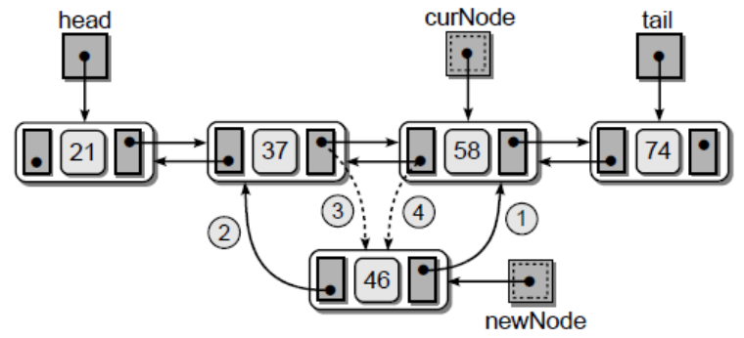
List Operations – Adding Node

Slide 14
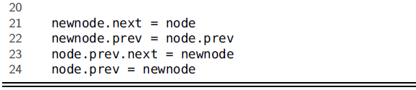
List Operations – Adding Node

Slide 15
List Operations – Removing Nodes
Assignment

Slide 16
The Circular Linked List
The nodes in a circular linked list are organized in a linear fashion the same as those in a singly or doubly linked list.
Circular linked list can have single or double links.
In a singly linked version, every node has a successor while in a doubly linked version every node has a successor and predecessor.
The nodes in a circular list have the same structure as those in the linear list versions. The only difference is the next field of the last node links to the first, and in the doubly linked version, the prev field of the first node links to the last.

Slide 17
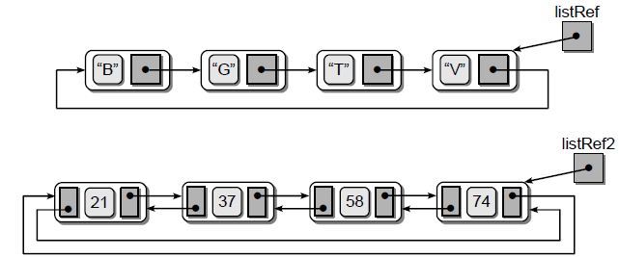
The Circular Linked List

Slide 18
The Circular Linked List - Traversals
The traversal process begins by initializing curNode to reference the last node in the list.
The traversal reference begins at the last node instead of the first because we are going to terminate the traversal when it again reaches the last node, after iterating over the entire list.
The termination of the loop is handled by the boolean variable done, which is initialized based on the status of listRef.
If the list is empty, done will be set to False and the loop never executes. When the list contains at least one node, done will be initialized to True and the loop is executed.

Slide 19
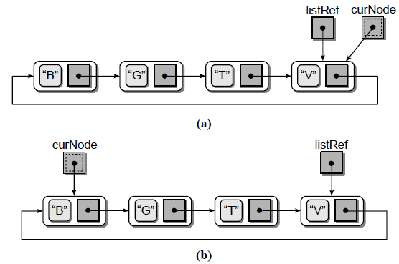
The Circular Linked List - Traversals

Slide 20
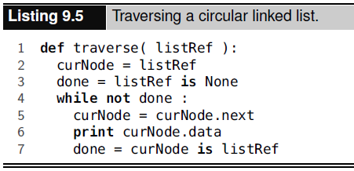
The Circular Linked List - Traversals

Slide 21
The Circular Linked List - Traversals
In the linear versions of the linked list, the first step in the body of the loop was to visit the current node (i.e., print the contents of the node.data field) and then advance the traversal reference to the next node.
In this version, we must first advance curNode and then perform the visit operation.
In order to begin the traversal with the first node, the temporary reference must be advanced to the first node in the list.
Finally, done is updated by examining curNode to determine if it has again reached the last node in the list, as referenced by the listRef reference.
curNode was initialized to be an alias of listRef, but it was advanced at the beginning of the loop.
Thus, when curNode again reaches the end of the list, we know every node has been visited and the loop can terminate.

Slide 22
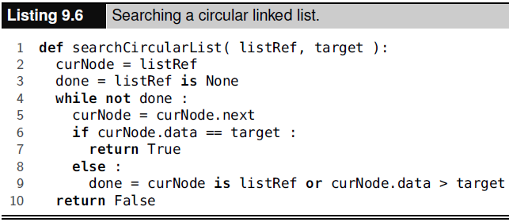
The Circular Linked List - Searching
The search operation requires a traversal through the list, although it can terminate early if we encounter the target item or reach an item larger than the target.

Slide 23
The Circular Linked List – Adding a Node
Adding nodes to an ordered circular linked list is very similar to that of the ordered linear versions.
There are four cases,
the list is empty when adding the node;
the new node is inserted at the front;
the new node is inserted at the end; or
the node is inserted somewhere in the middle.

Slide 24
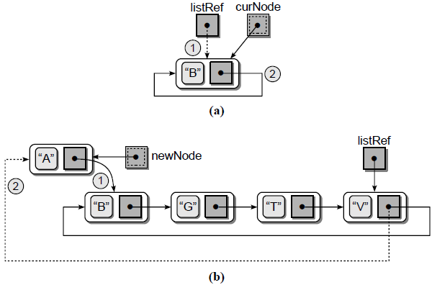
The Circular Linked List – Adding a Node

Slide 25
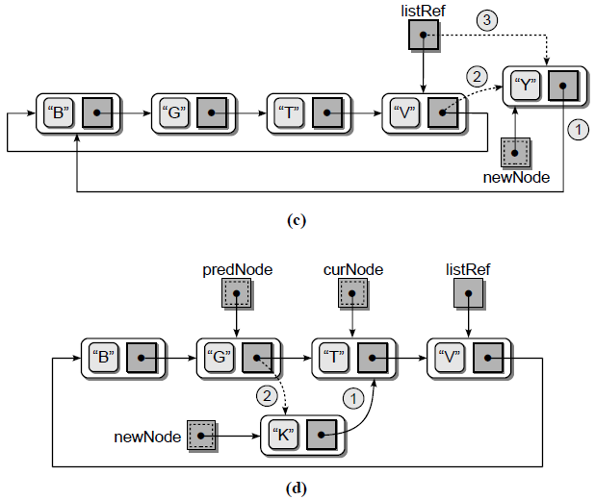
The Circular Linked List – Adding a Node

Slide 26
The Circular Linked List – Adding a Node
newNode = ListNode(value) if self.listRef is None: # empty list self.listRef = newNode newNode.next = newNode self.size+=1 elif value < self.listRef.next.data: # insert in front newNode.next = self.listRef.next self.listRef.next = newNode self.size+=1 elif value > self.listRef.data: # insert in back newNode.next = self.listRef.next self.listRef.next = newNode self.listRef = newNode self.size += 1

Slide 27
The Circular Linked List – Adding a Node
else: # insert in the middle # Position the two pointers. predNode = None curNode = self.listRef done = self.listRef is None while not done: predNode = curNode curNode = curNode.next done = curNode is self.listRef or curNode.data > value # Adjust links to insert the node. newNode.next = curNode predNode.next = newNode self.size += 1

Slide 28
The Circular Linked List – Removing a Node
Exercise

Slide 29
Multi-Linked Lists
A multi-linked list is one in which each node contains multiple link fields which are used to create multiple chains within the same collection of nodes.
In a multi-linked list, chains can be created using multiple keys or different data components to create the multiple links.

Slide 30
Multi-Linked Lists
Suppose we want to create a multi-linked list containing two chains in which the nodes are linked and sorted by id number in one chain and by name in the other.
The first node in each chain is referenced by a separate head pointer.
The listById reference indicates the first node in the chain sorted by id number while listByName indicates the first node in the chain sorted by name.

Slide 31
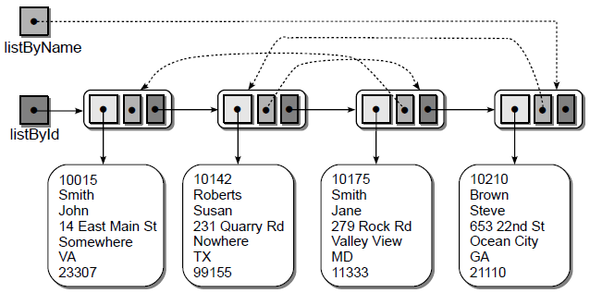
Multi-Linked Lists

Slide 32
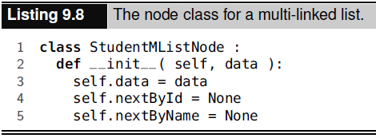
Multi-Linked Lists
The nodes in the multi-linked list can be traversed by either chain, the dashed links or the solid links, based on the desired order.
To create a multi-linked list, the nodes must contain multiple link fields, one for each chain.

Slide 33
Multi-Linked Lists
When inserting nodes into the multi-linked list, a single node instance is created, but two insertions are required.
After creating the new node, the multi-linked list is treated as two separate singly linked lists.
Thus, the node must first be inserted into the chain ordered by id and then in the chain ordered by name.

Slide 34
Multi-Linked Lists - Implementation
def traverseNext(self, Node,data): curNode = Node while (curNode != None): if curNode.data==data: return nextlink, True nextlink = curNode curNode = curNode.next return nextlink, False def traverseChild(self, Node): curNode = Node while (curNode != None): nextchild = curNode curNode = curNode.child return nextchild
class Node: def __init__(self, data): self.data = data self.next = None self.child = None class multiLevelLinkedList(): def __init__(self): self._head=None self._size=0

Slide 35
Multi-Linked Lists - Implementation
def createNode(self,data): duplicate = False if self._head==None: self._head=Node(data) self._size += 1 else: curNode=self._head newNode, duplicate= self.traverseNext(curNode,data) if duplicate == True: print ('item already exist, can not add into the list') return else: newNode.next=Node(data) self._size += 1

Slide 36
Multi-Linked Lists - Implementation
def createChild(self,parent,child): isParent=False curNode=self._head if (curNode==None): print('list is empty, can not create a child') return else: while(curNode!=None): if (curNode.data==parent and curNode.child==None): isParent=True curNode.child=Node(child) self._size += 1 elif (curNode.data==parent and curNode.child!=None): isParent=True tmpNode = self.traverseChild(curNode.child) tmpNode.child = Node(child) self._size += 1 curNode = curNode.next if isParent==False: print('{0} does not exist as parent, therefore {1} is not added as child of {0}'.format(str(parent),str(child)))

Slide 37
Multi-Linked Lists - Implementation
def printList(self): curNode=self._head while (curNode!=None): print(curNode.data , end=' ') if curNode.child!=None: tmpNode = curNode.child while (tmpNode!=None): print("-> ", tmpNode.data, end=" ") tmpNode = tmpNode.child curNode=curNode.next

Slide 38
Multi-Linked Lists - Implementation
mll=multiLevelLinkedList() mll.createNode(1) mll.createNode(2) mll.createNode(3) mll.createChild(1,2) mll.createChild(1,3) mll.createChild(1,8) mll.createChild(1,9) mll.createChild(2,4) mll.createChild(2,5) mll.createChild(3,6) mll.createChild(3,7) mll.createChild(2,10) mll.createChild(2,11) mll.createChild(11,12) mll.createChild(13,14) mll.printList() print(Style.RESET_ALL+'\n Size: ',len(mll))

Slide 39
Multi-Linked Lists - Implementation
11 does not exist as parent, therefore 12 is not added as child of 11
13 does not exist as parent, therefore 14 is not added as child of 13
1 -> 2 -> 3 -> 8 -> 9
2 -> 4 -> 5 -> 10 -> 11
3 -> 6 -> 7
Size: 13

